Slide 1
Intraday feature with a Two-stage model
Group Two
Oct 4th, 2024

Slide 2
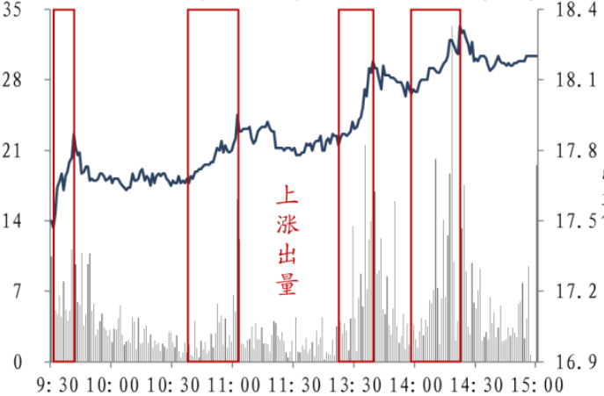
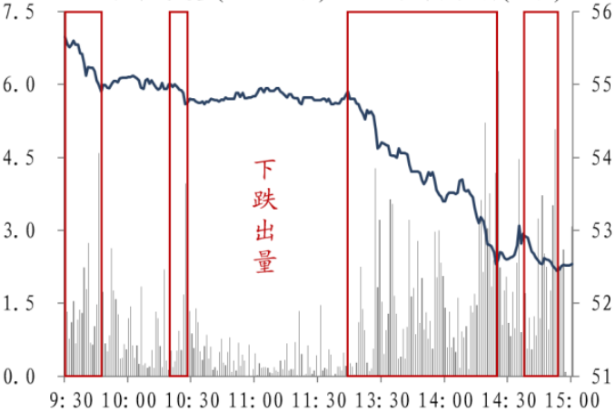

Theoretical Background
Researchers argue the correlation between intraday vol-price, will give out a better prediction to future returns. Because Price increase with Vol expansion Often means a good signal while vice verse.
With more features, we proved that the subsample ensemble model idea is better
Price increase with Vol expansion
Price decline with Vol expansion
intra-vol
-P long
+P short
Tradition revision
-P, +vol low-corr long
+P, +vol high-corr short
Intra-Price
-P, -vol high-corr short
+P, -vol low-corr long
new PV_corr_avg
Intraday feature with a Two-stage

Slide 3
Feature Construction
For intraday PV_corr_avg alpha
We proved that using 1min delay volume is better than no delay.
We use rank correlation, and it proved to be better both on is/os.
We think that it is better to use dpv_corr_allday for the correlation around opening/closing hours will contain noise. And it is do better both on is/os.
We use upret(Team2, 0923), cvx-of-vol(Team2, 0629), dpvcorr(Team2, 1004) three new features with bm features
to prove something we once held a belief about the model.
Intraday feature with a Two-stage

Slide 4
Model enhance
Three features each / together proved to be useful on bmv8 and bmv3 both is/os
With bmv8 + 3new features, history ideas we’ve presented before become useful. A new main idea also proved to be useful.
Diversity is important with ensemble model.
We set the colsample_bytree=0.75 subsample=0.95 and just use 2 model to train rather the 10 model we used by Adaboost.
We use the residual of the first model as the label of second model, and boosting them together.
By setting colsample_bytree=0.75 subsample=0.95 alone is useful, using 2 residual subsample model proved to be even better both is/os
Intraday feature with a Two-stage

Slide 5
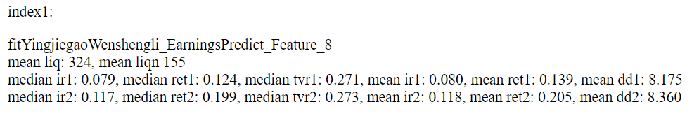
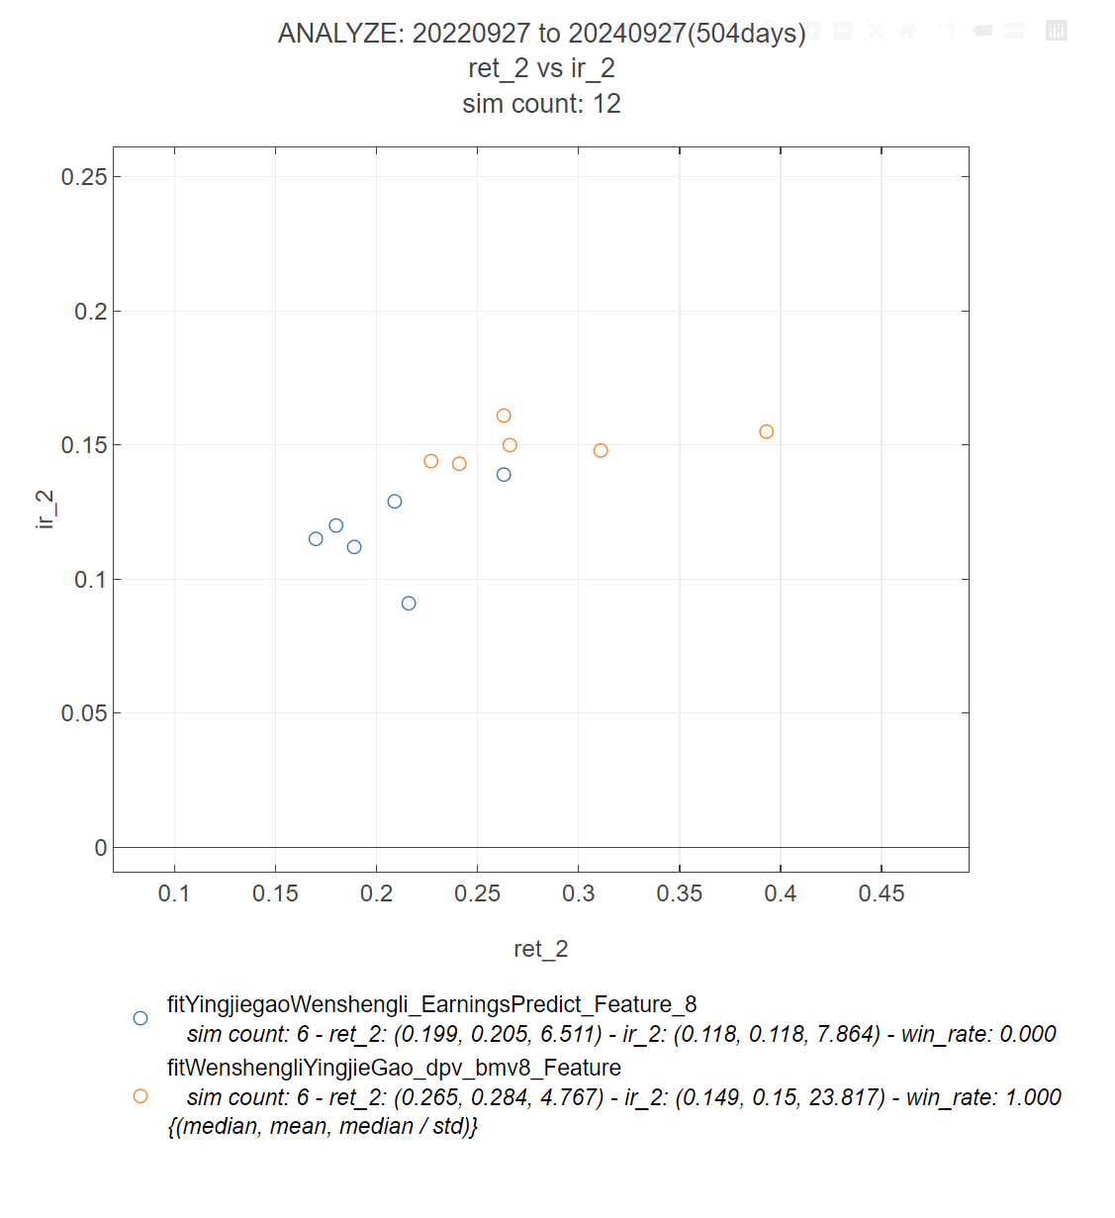
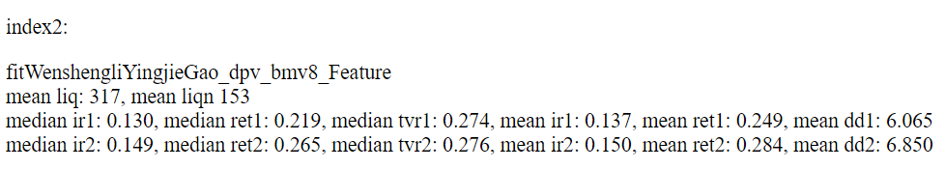
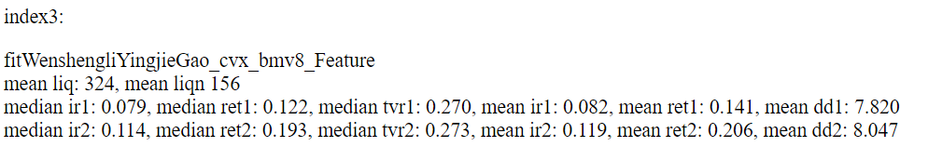
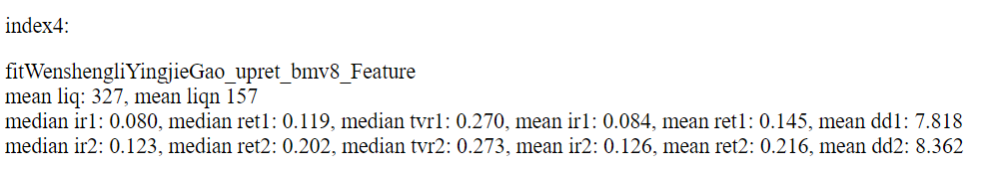
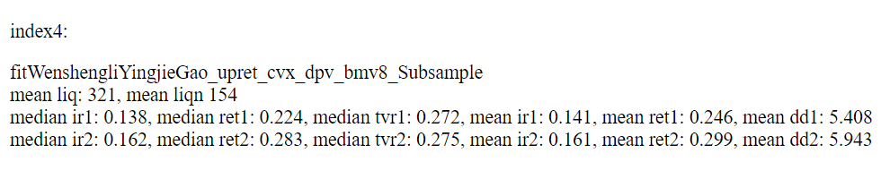
Performance
Intraday feature with a Two-stage

Slide 6
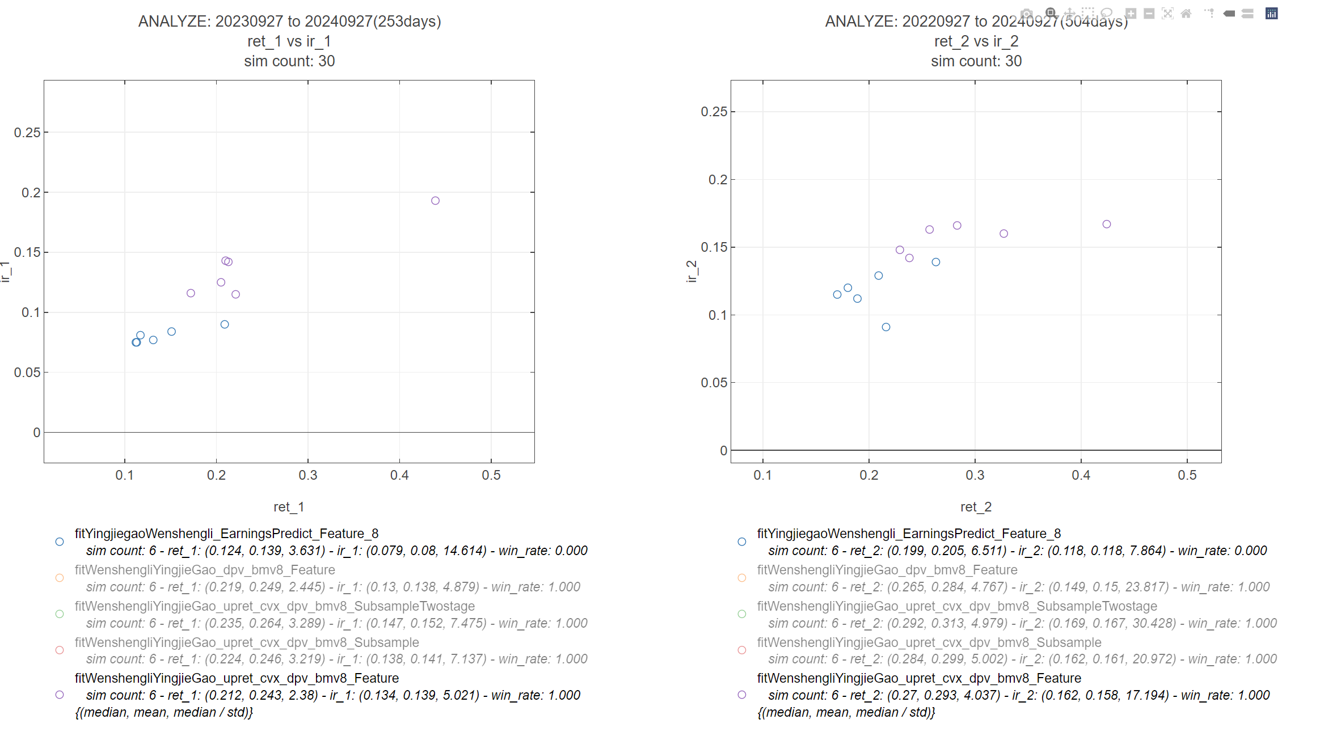
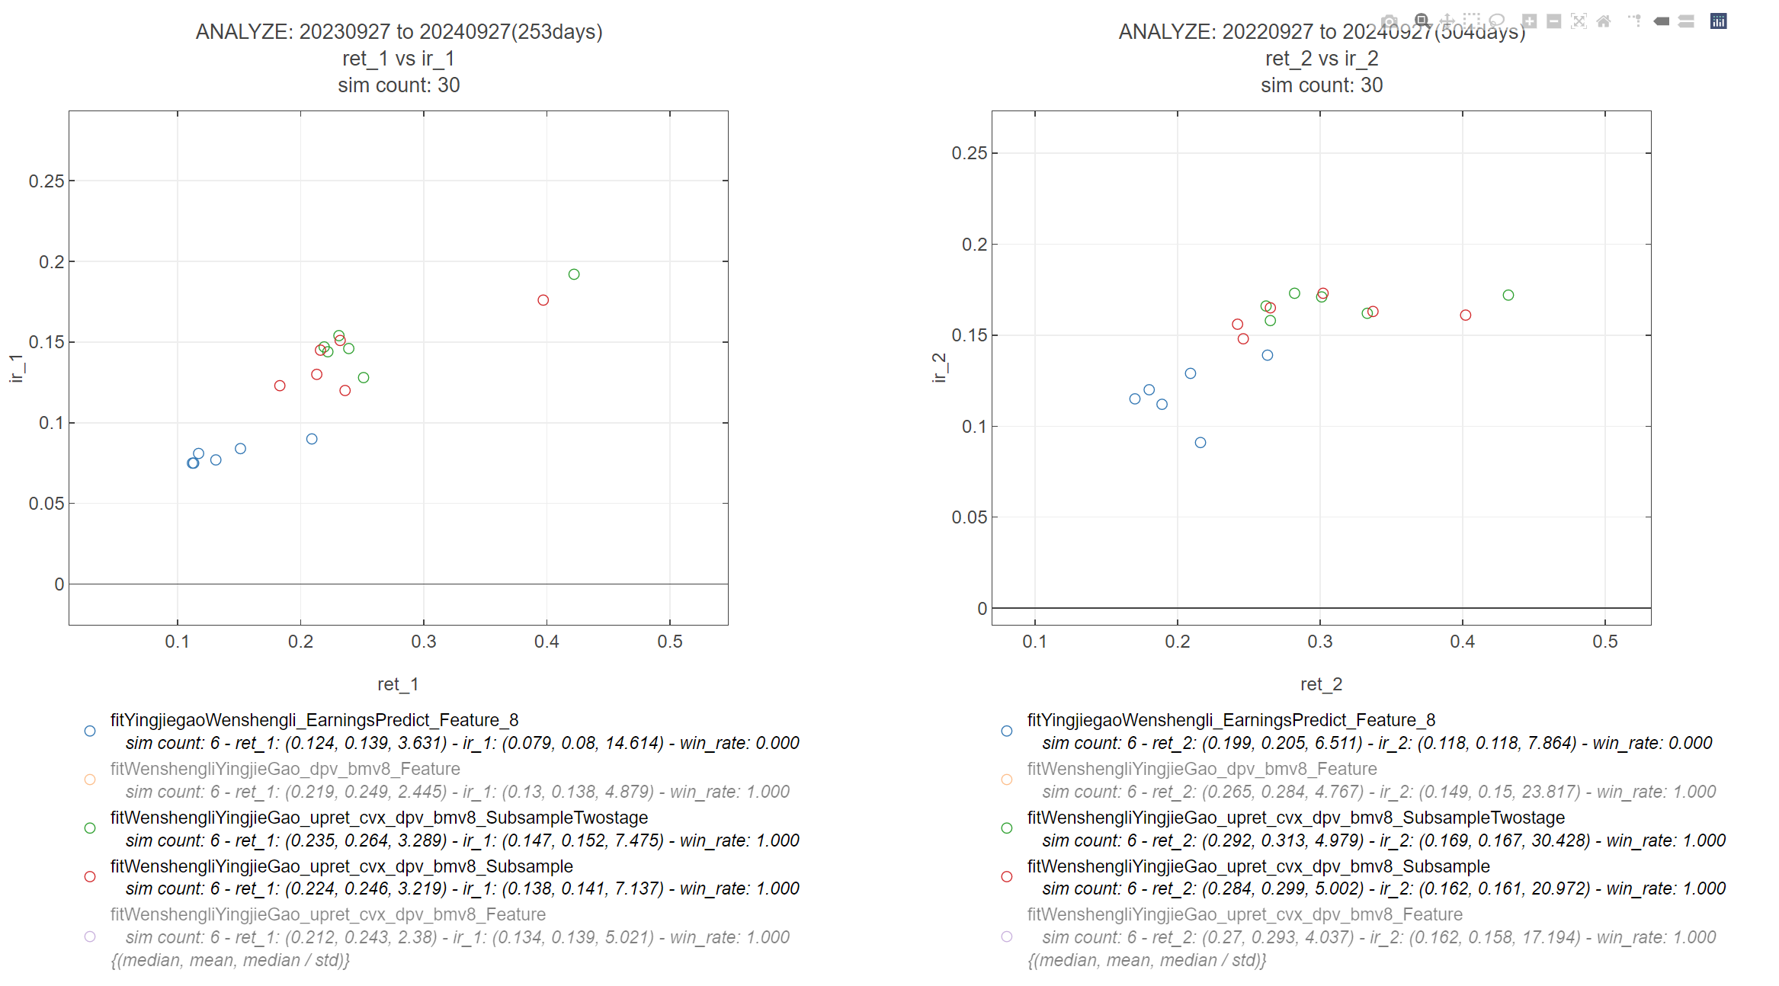
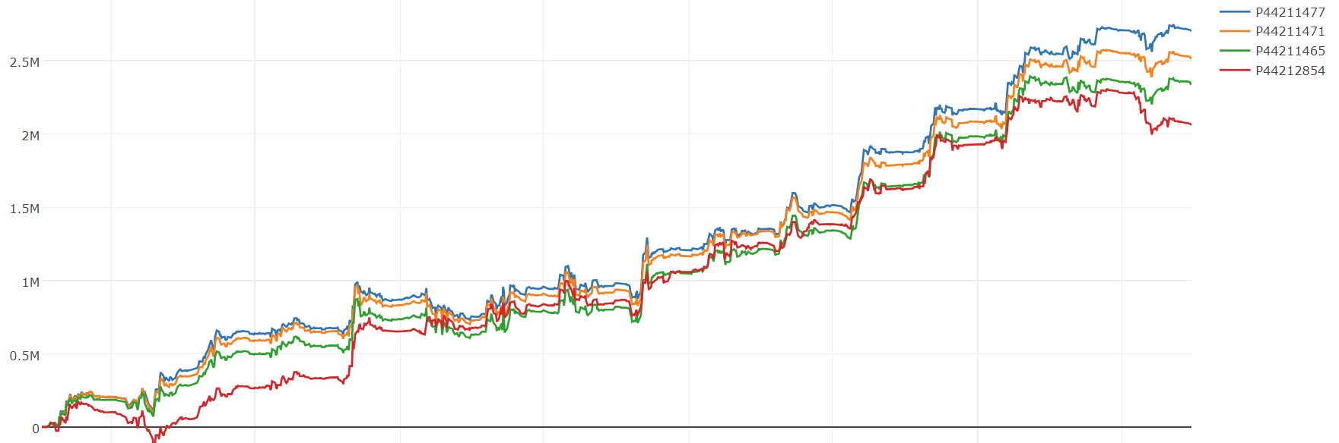
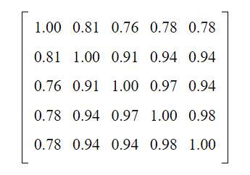
Performance
Intraday feature with a Two-stage

Slide 7
Thanks !
Intraday feature with a Two-stage

